Slide 1
Project Presentation
Data 602
Meghana Kompally
Serena Sun
Jannatul Naeema

Slide 2
Introduction
Domain: Environment and Safety
Three data sets: Calgary’s Historical Air Quality Data set, Calgary’s population growth data, WHO global air quality data.
Within this domain, we are trying to investigate various questions pertaining to air quality of Calgary .
This analysis allows us to draw conclusions about the overall air quality status in Calgary giving us an idea of the precautions humans should take to protect our respiratory health and eco-friendly actions to take protect our environment.

Slide 3
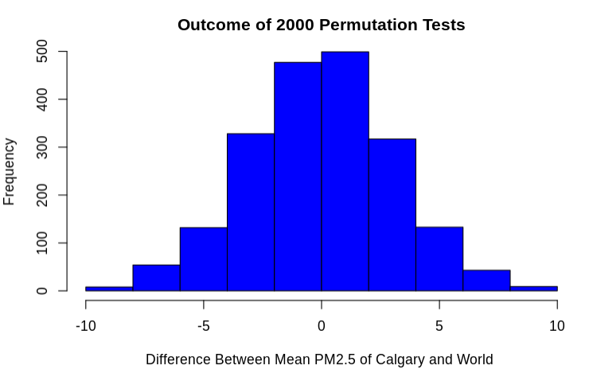
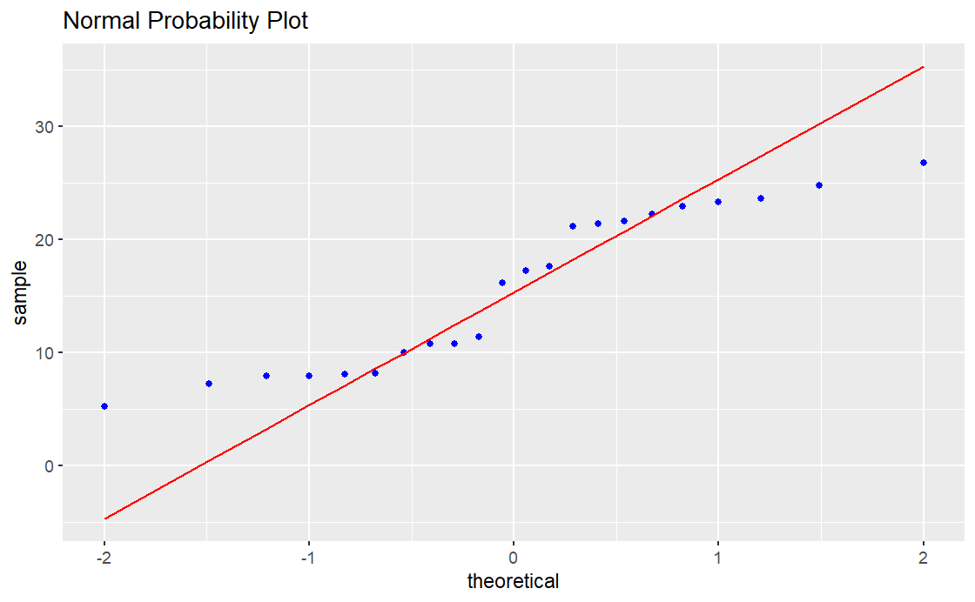
Question A: Is there any statistical difference between the particulate matter recorded in Calgary vs. particulate matter recorded globally in order to gain evidence to support or reject our hypothesis that PM2.5 globally is equal to PM2.5 in Calgary?
Hypothesis Testing (Two Populations)
Using Permutation Test and Student T-test with Normality condition
H₀ : µ_{Calgary, PM 2.5} - µ_{World, PM 2.5} = 0
H_{A} : µ_{Calgary, PM 2.5} - µ_{World, PM 2.5} ≠ 0
Permutation test for PM 2.5 at Calgary and the rest of the World
Student T-test P-value: 5.782e-10 < 0.05 Reject Null Hypothesis
Checking Normality Condition - Met
Actual mean difference (black line): -12.82158 μg.m3 Empirical P-Value= 0 < 0.05 Reject Null Hypothesis

Slide 4
Conclusion: Question A
The yearly mean of particulate matter recorded of Calgary is not same as the yearly mean of particulate matter recorded of the rest the world.
95 percent confidence interval within -15.12805 to -10.51511

Slide 5
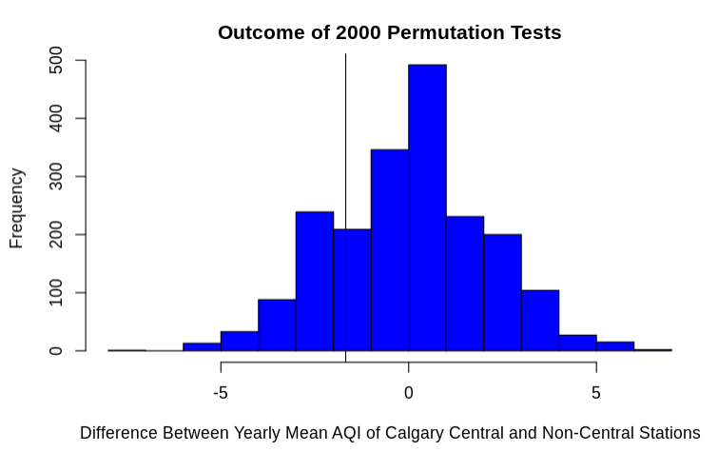
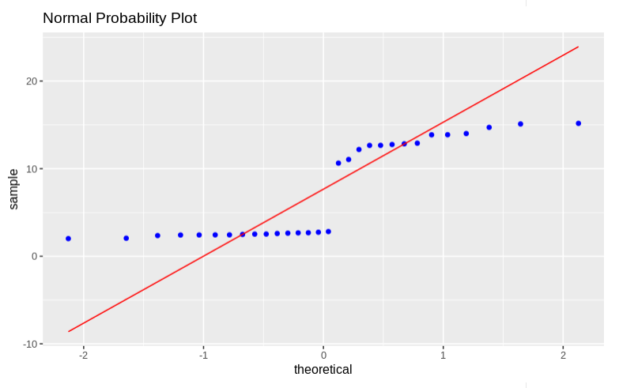
Question B: Is there any statistical difference between the Air Quality Index (AQI) measured in the central stations of Calgary and the AQI measured in the Southeast/Northwest and East stations of Calgary.
Hypothesis Testing (Two Population)
Permutation test and Student T-test with normality condition
H₀ : µ_{Central, Air Quality Index} - µ_{Non-Central, Air Quality Index} ≤ 0 H_{A} : µ_{Central, Air Quality Index} - µ_{Non-Central, Air Quality Index} > 0
Permutation test for yearly mean AQI between Calgary central stations and non-central stations
Student T-test P-value: 0.7822 > 0.05 Fail to Reject Null Hypothesis
Checking Normality Condition - Not Met Since condition is not met, t-test result is not valid
Actual mean difference (black line): -1.677021 Empirical P-value: 0.785 > 0.05 Fail to Reject Null Hypothesis

Slide 6
Conclusion: Question B
The yearly mean of AQI of the central stations is less than or equal to the rest of the stations. This result may have been due to more people using the public transit in central calgary (especially downtown area). Higher number of commercial buildings compared to residential leading to lower energy consumption hence lower pollution.

Slide 7
Guiding Question C
Is there any correlation between the major greenhouse gasses -Nitrogen Dioxide (NO₂) and Nitric Oxide (NO) and Particulate Matter of 2.5 mass (PM2.5) with the population growth of Calgary over the years? This is to check if Calgary's level of greenhouse gas emissions and the amount of air particles in the air is related to the population

Slide 8
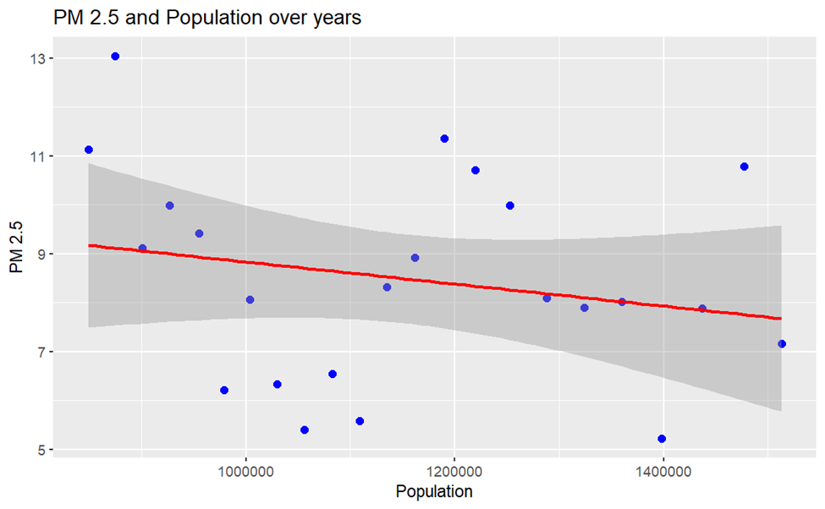
Question C (Part 1): Linear Regression Analysis of the recorded PM2.5 and Calgary population growth over the overlapping years.
Our Hypothesis:
H₀: The PM2.5 values recorded in Calgary in Calgary cannot be expressed as a linear function of the population growth yearly H_{A}:The PM2.5 values recorded in Calgary in Calgary can be expressed as a linear function of the population growth yearly
Correlation coefficient (r): -0.2156038 Weak negative correlation
After further analysis the linear model gives the following equation:
PM 2.5 = A + B * Population + e A= 11.092034603450 B= -0.000002256207 PM 2.5 = 11.092034603450 + (-0.000002256207) * Population + e
A scatterplot of PM2.5 against Calgary population over the years (to show correlation).

Slide 9
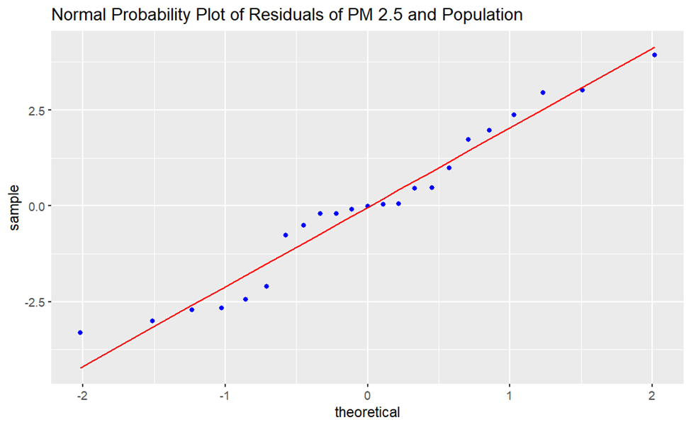
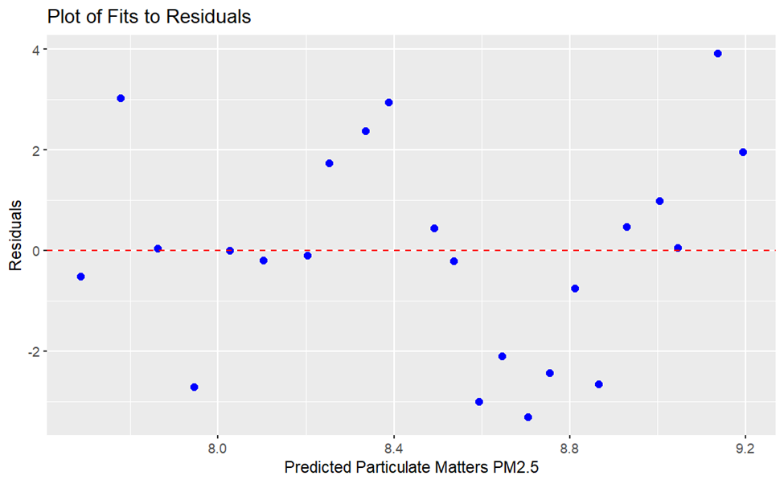
Checking for Normality- Condition is Met
Checking for homoscedasticity- Condition is Met
Since the conditions are met, so: F value: 1.0240 P-value(>F): 0.3231 > 0.05 Fail to reject the null hypothesis. So, population growth in Calgary cannot be expressed as a linear function of the yearly PM2.5 values recorded in Calgary.
Since, our parameters cannot be expressed as a linear function, the model testing to prove this model is not completed.

Slide 10
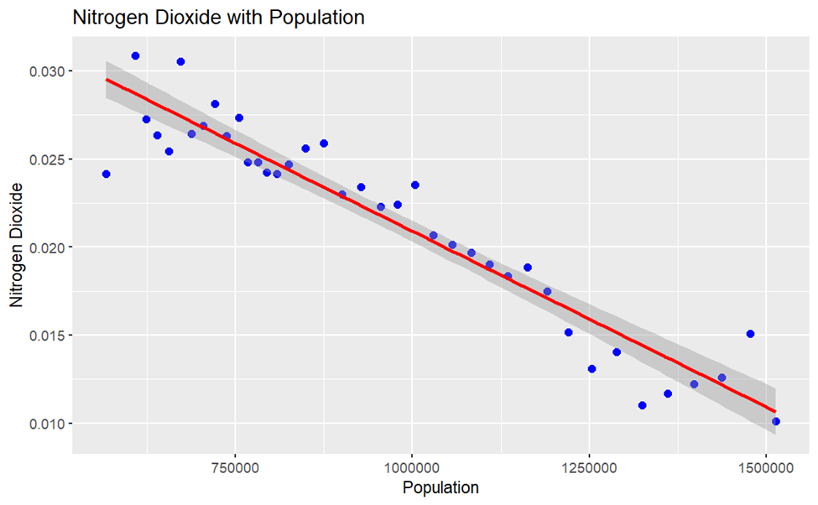
Question C (Part 2): Linear Regression Analysis of the recorded Nitrogen Dioxide (mg/l) and Calgary population growth over the overlapping years.
Our Hypothesis:
H₀: The yearly Nitrogen Dioxide values recorded in Calgary cannot be expressed as a linear function of the population growth in Calgary H_{A} : The yearly Nitrogen Dioxide values recorded in Calgary can be expressed as a linear function of the population growth in Calgary
A scatterplot of Nitrogen Dioxide against Calgary population over the years.
Correlation coefficient (r): -0.9497451 Strong negative correlation
After further analysis the linear model gives the following equation:
Nitrogen Dioxide = A + B × Population + e A= 0.04086983004144 B= -0.00000001996488 Nitrogen Dioxide = 0.04086983004144 + (-0.00000001996488) * Population + e

Slide 11
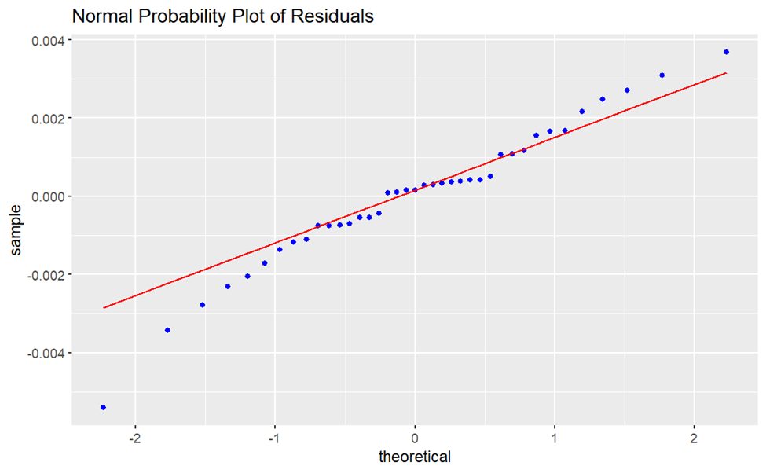
Checking for homoscedasticity- Condition is Met
Checking for Normality- Condition is Met
Since the conditions are met, so: F value: 340.6 P-value(>F): <2e-16 < 0.05
Reject the null hypothesis. So, population growth in Calgary can be expressed as a linear function of the yearly Nitrogen Dioxide values recorded in Calgary.
Since, our parameters can be expressed as a linear function, linear modeling by bootstrapping for r, A and B values is conducted to determine how the resulting model (equation) compares to the one produced in the previous slide

Slide 12
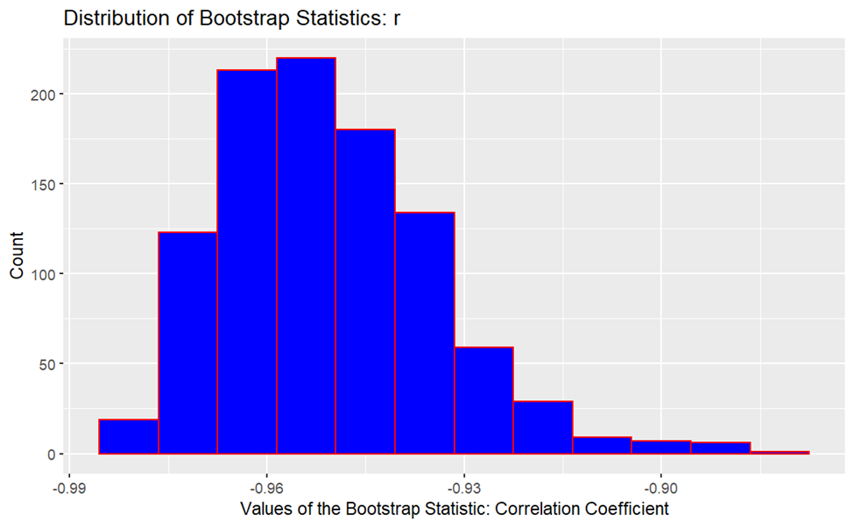
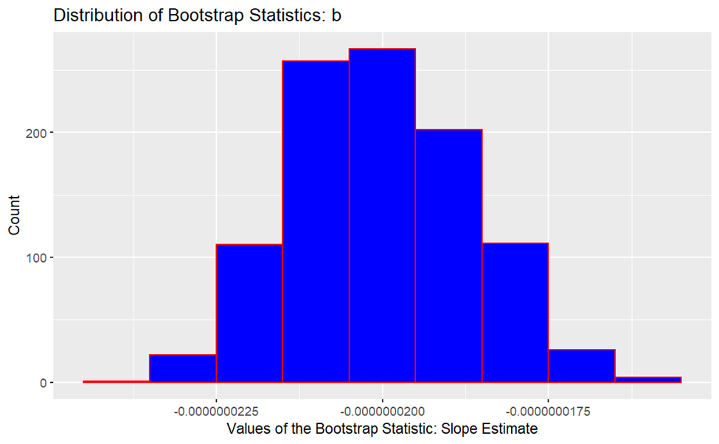
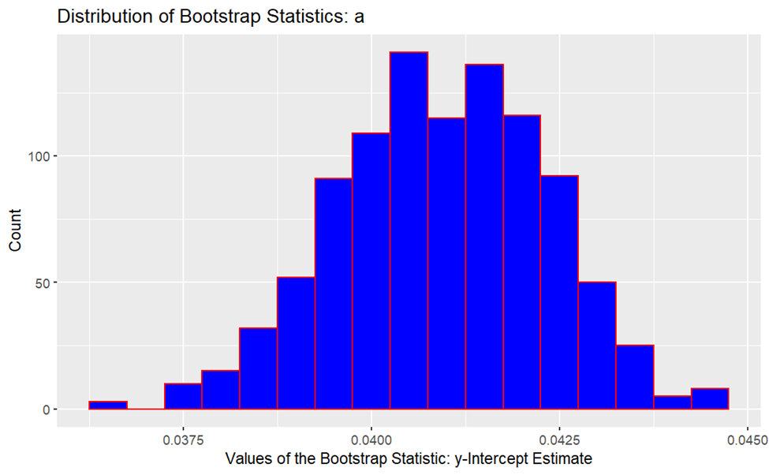
Bootstrap Distribution of r_{boot}
Bootstrap Distribution of b_{boot}
Mean Correlation Coefficient ( r_{boot}) = -0.9504573 95% Confidence Interval: (2.5%, 97.5%) -0.9763399 ≤ r ≤ -0.9144689
Mean Slope Estimate: -2.001939×10⁻⁰⁸ 95% Confidence Interval: (2.5%, 97.5%) -2.248524×10⁻⁰⁸ ≤ b ≤ -1.736453×10⁻⁰⁸
Bootstrap Distribution of a_{boot}:
Mean Y-intercept Estimate: 0.04089894 95% Confidence Interval: (2.5% , 97.5%)
0.03821873 ≤ a ≤ 0.04363896
Bootstrapped Equation: Nitrogen Dioxide = 0.04089894 + (-2.001939×10⁻⁰⁸ ) * Population + e
Least-squares statistics equation: Nitrogen Dioxide = 0.04086983004144 + (-1.996488×10⁻⁰⁸) * Population + e

Slide 13
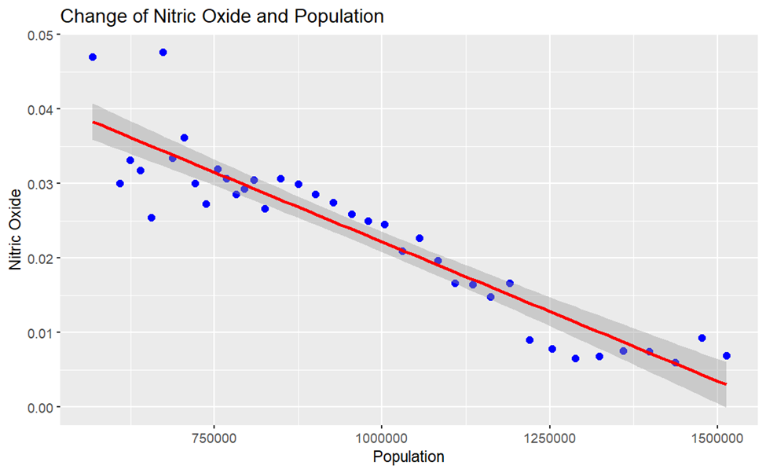
Question C (Part 3): Linear Regression Analysis of the recorded Nitric Oxide (ppm) and Calgary population growth over the overlapping years.
Our Hypothesis:
H₀: The yearly Nitric Oxide values recorded in Calgary cannot be expressed as a linear function of the population growth in Calgary H_{A} : The yearly Nitric Oxide values recorded in Calgary can be expressed as a linear function of the population growth in Calgary
A scatterplot of Nitric Oxide against Calgary population over the years.
Correlation coefficient (r): -0.9275725 Strong negative correlation
After further analysis the linear model gives the following equation:
Nitric Oxide = A + B * Population + e A= 0.0595543100516 B= -0.000002256207 Nitric Oxide = 0.0595543100516 + (-0.0000000373782 ) * Population + e

Slide 14
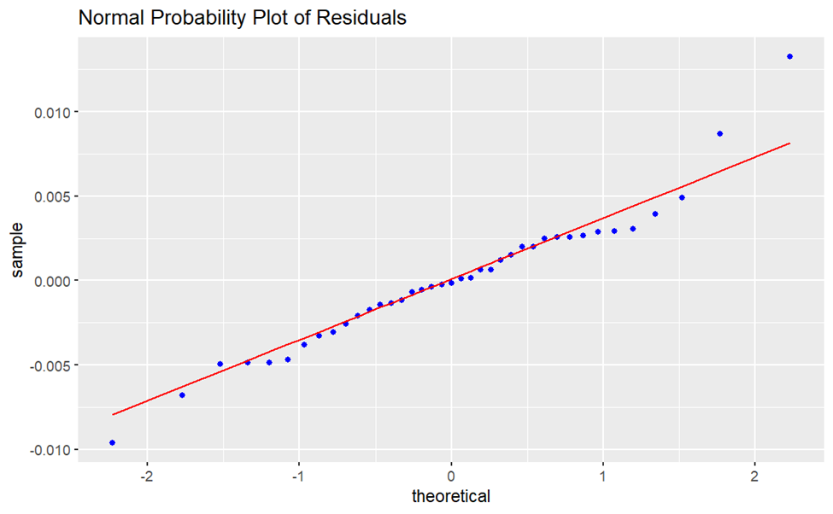
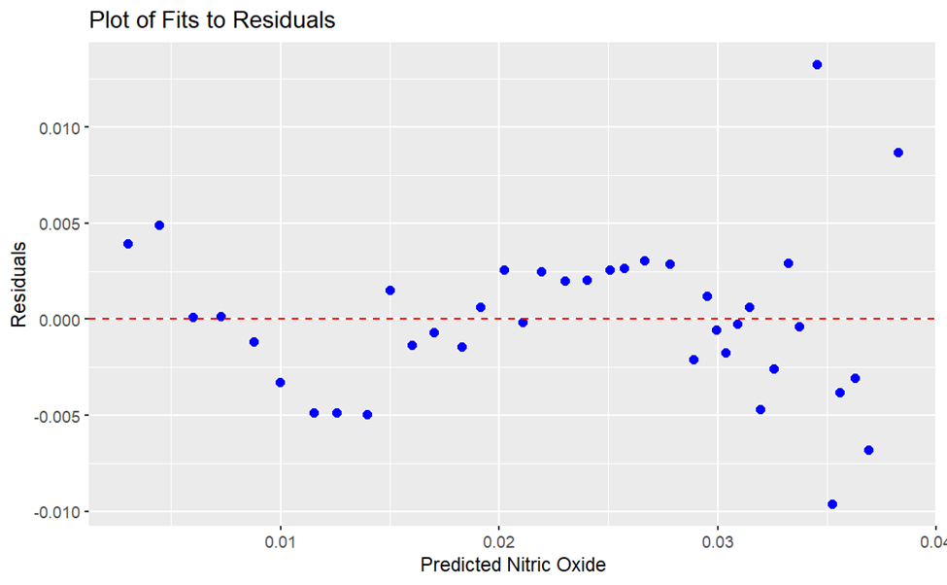
Checking for Normality- Condition is Met
Checking for homoscedasticity- Condition is Met
Since the conditions are met, so: F value: 228 P-value(>F): 2e-16 < 0.05
Reject the null hypothesis. So, population growth in Calgary can be expressed as a linear function of the yearly Nitric Oxide values recorded in Calgary.
Since, our parameters can be expressed as a linear function, linear modeling by bootstrapping for r, A and B values is conducted to determine how the resulting model (equation) compares to the one produced in the previous slide

Slide 15
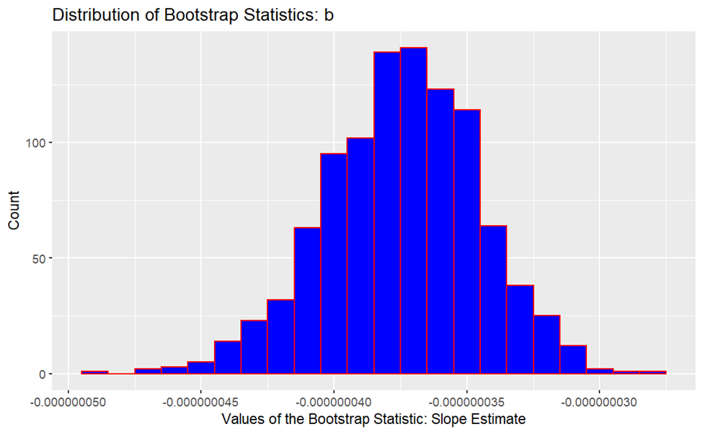
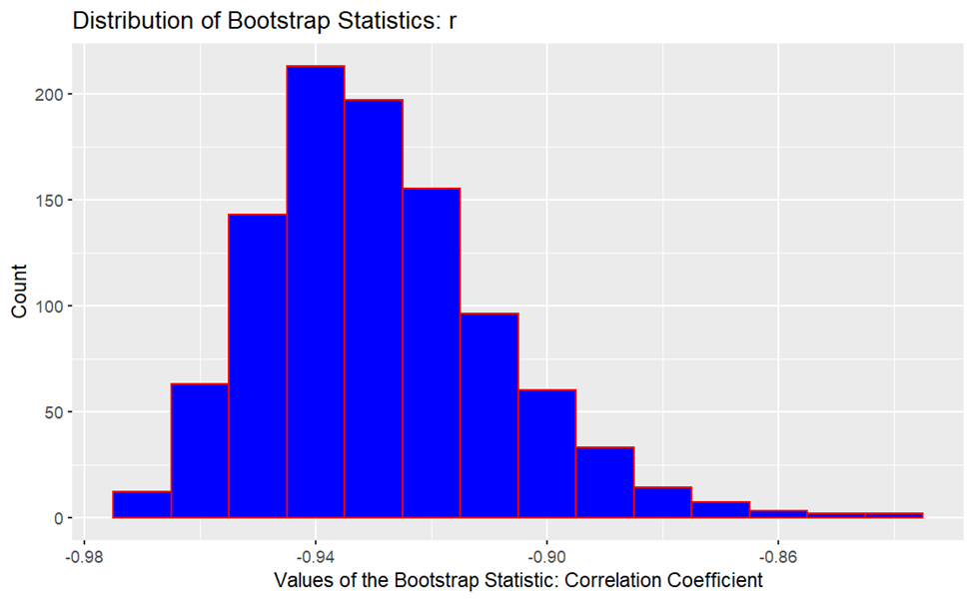
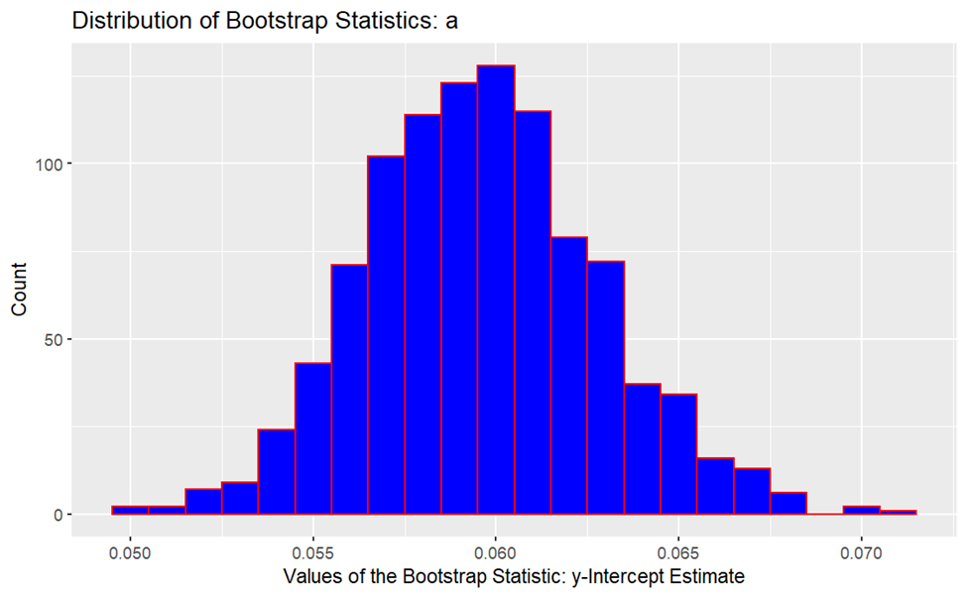
Bootstrap Distribution of r_{boot}
Bootstrap Distribution of b_{boot}
Mean Correlation Coefficient ( r_{boot}): -0.9290379
95% Confidence Interval: (2.5%, 97.5%) -0.9607345 ≤ r ≤ -0.8825924
Mean Slope Estimate (B): -3.744776×10⁻⁰⁸
95% Confidence Interval: (2.5%, 97.5%) - 4.350186×10⁻⁰⁸ ≤ b ≤ - 3.198461 ×10⁻⁰⁸
Bootstrap Distribution of a_{boot}:
Mean Y-intercept Estimate (a): 0.05962442
95% Confidence Interval: (2.5%, 97.5%) 0.05358987 ≤ a ≤ 0.06625294
Bootstrapped Equation: Nitric Oxide = 0.05962442 + ( -3.744776×10⁻⁰⁸ ) * Population + e
Least-squares statistics equation: Nitric Oxide = 0.0595543100516 + (-3.73782 × 10⁻⁰⁸ ) * Population + e

Slide 16
Conclusion: Question C and Next Steps
PM 2.5 and population regression analysis, we found that there was a weak negative correlation and based on the p-value, PM2.5 yearly cannot be expressed as a linear function of the population growth in Calgary.
The Nitrogen Dioxide and Nitric Oxide values recorded yearly in Calgary can be expressed as a linear function of the population growth in Calgary
Although one would expect NO2 and NO emission to increase as population increases, these parameters have been decreasing in Calgary for the past 2 decades due to improved technology at emission sources
Next Steps:
Using other parameters in the “Historical Air Quality” data set to analyse and visualize the data further
Using non pollutant parameters such as wind speed, temperature, relative humidity etc. to analyse the climate/weather patterns in Calgary
Linear models in question 3 could be used to do some prediction analysis for the future

Slide 17
Thank you!

